Slide 1
Freeman Army Airfield Museum
Flight Simulators 2021
And now there are two…..
Second flight simulator, for kids under 12 years old

Slide 2
A little info about me .....
Larry Bothe, from Seymour, Indiana
(Contact info on last slide)
8500-hour pilot, FAA Certified Flight Instructor
Rated in Airplanes, Seaplanes, Helicopters & Gliders
Lived in Chicago 1991-1998
President of CAEUG in 1996; VP – Programs before that
Curator; Freeman Army Airfield Museum

Slide 3
What we’ll cover today
Background; the museum, why flight simulators
The first simulator, how that came about
Changes to the first one over the last 2 years; a lot!
The advent of the Kiddie Sim
Building on what we knew
Acquiring the equipment
Selecting software
Putting it together
The finished Kiddie Sim
Questions & Discussion

Slide 4
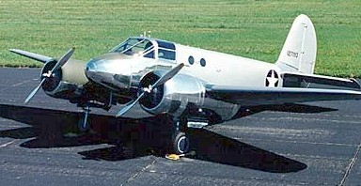
Freeman Army Airfield
Built in 9 mo. in 1942
Trained bomber pilots
9-weeks to learn…..
  Multi-engine
  Instrument flight
  Crew coordination
Had 250 AT-10 aircraft

Slide 5
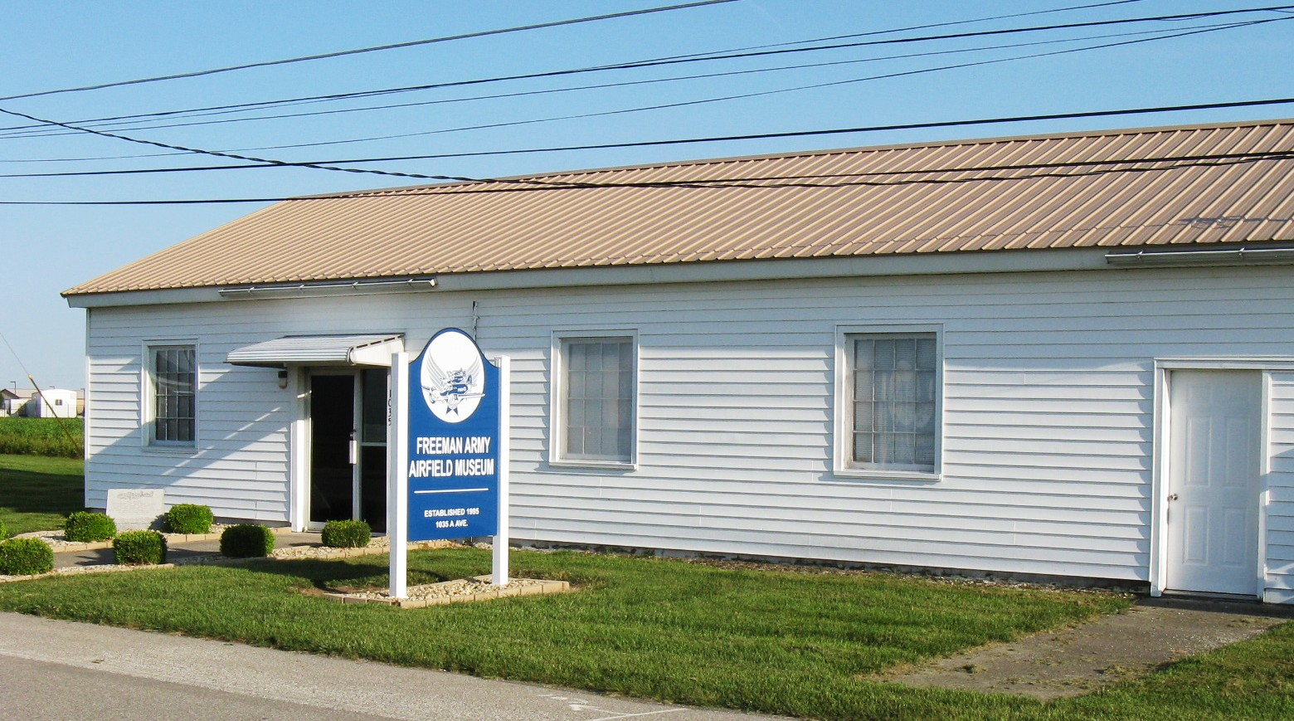
The Freeman Army Airfield Museum
I’m the Curator
2 buildings, 6000 sq. ft.
Concentrates on WWII

Slide 6
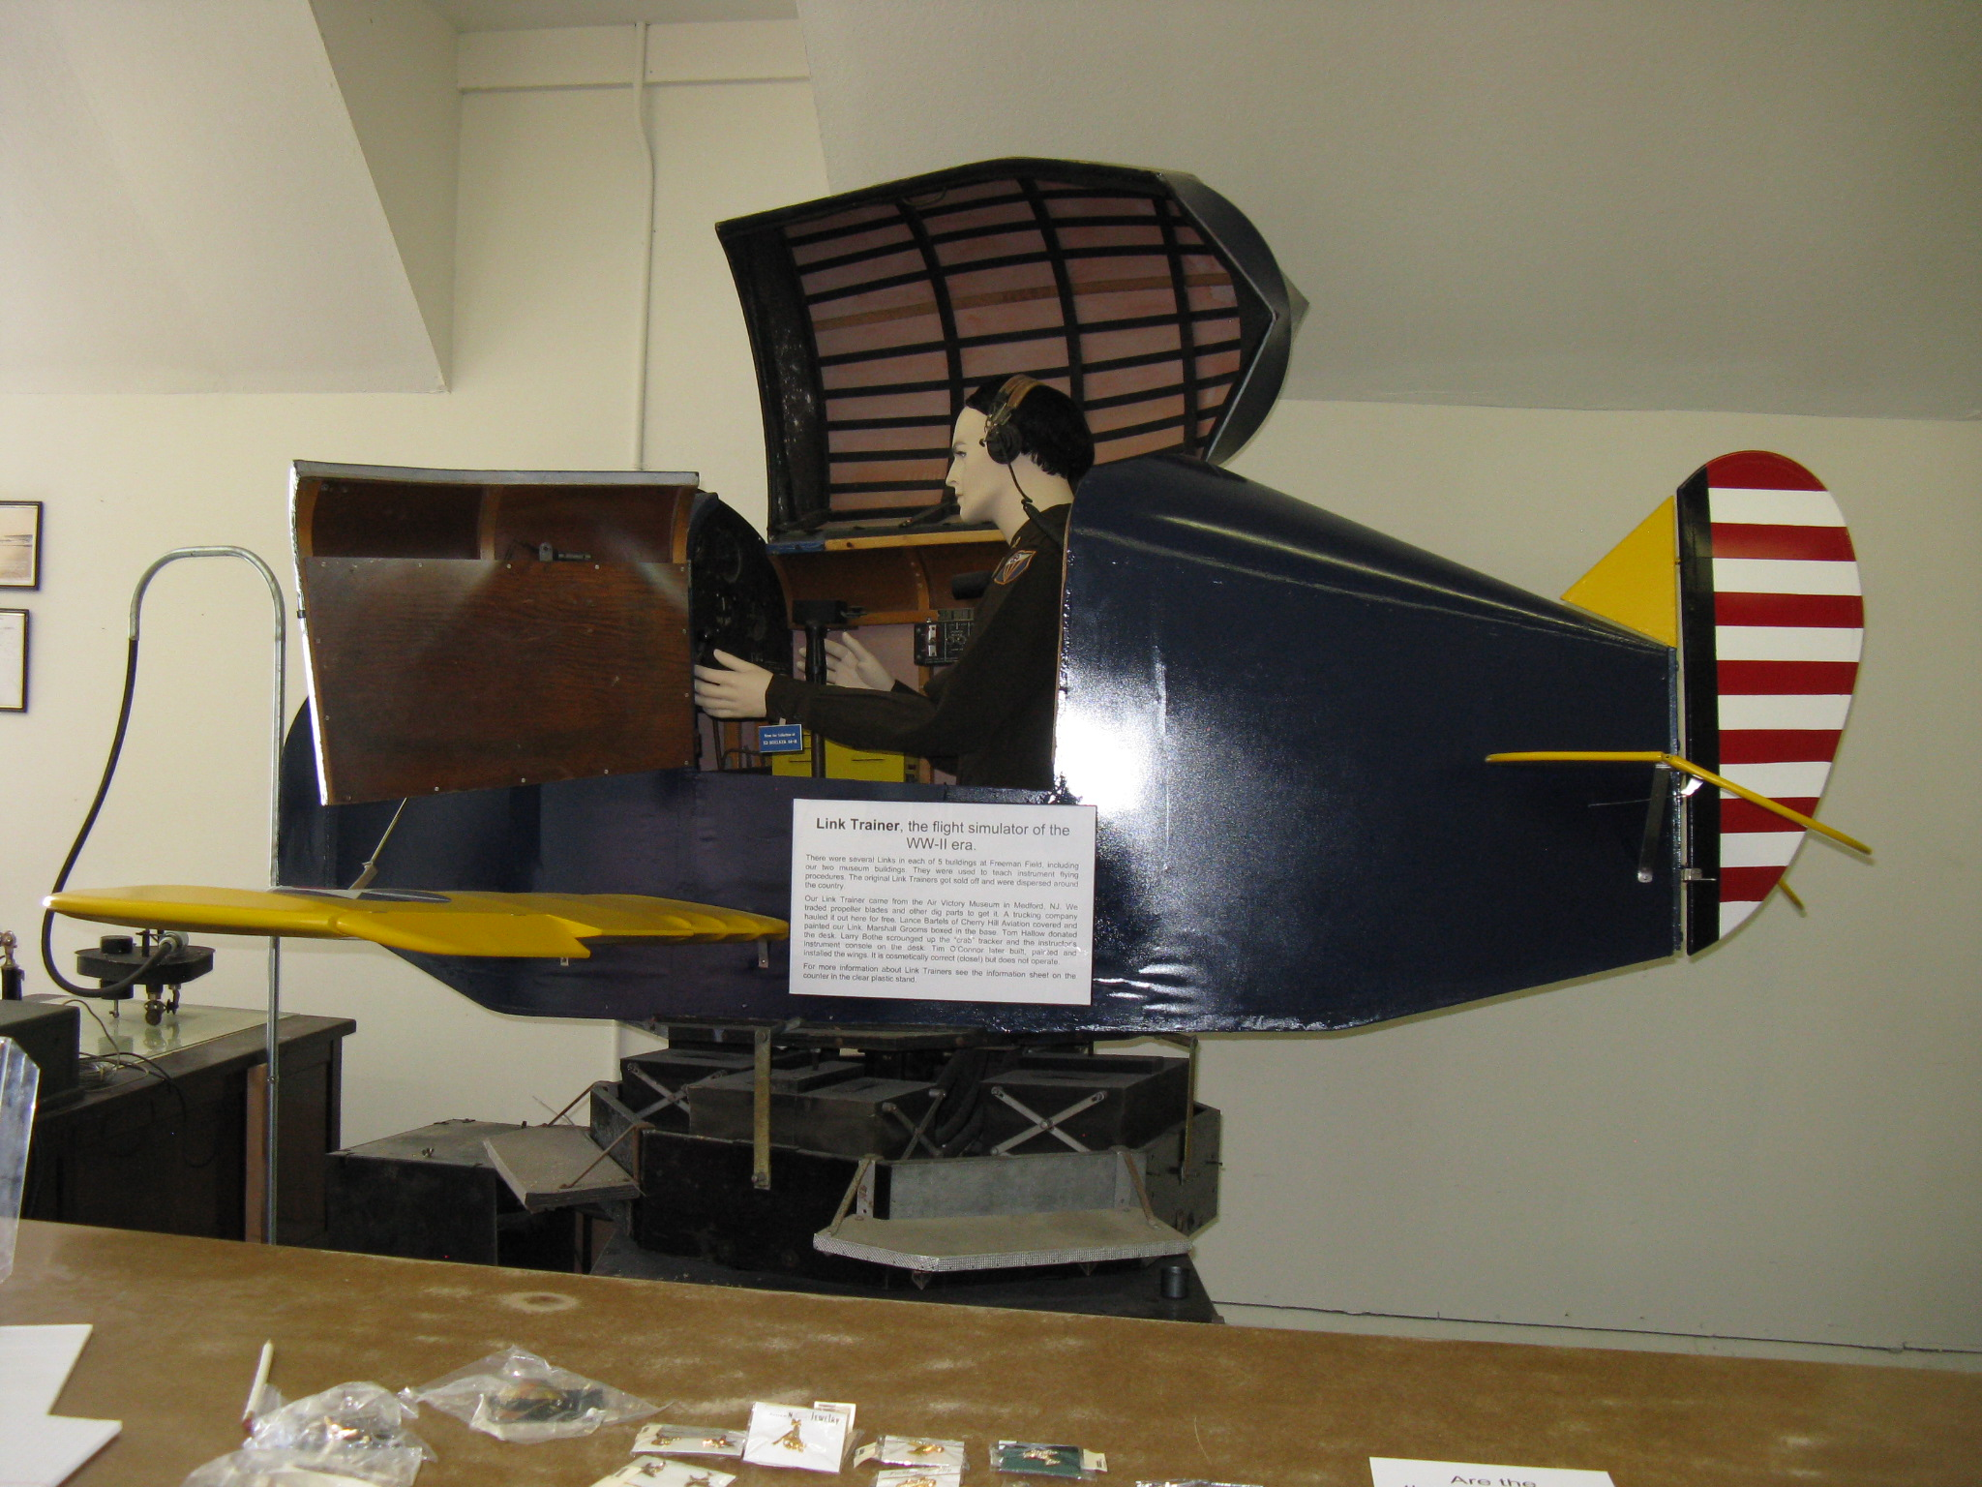
Link Trainer
WWII flight simulator
Museum has a Link Trainer
Kids want to fly it

Slide 7
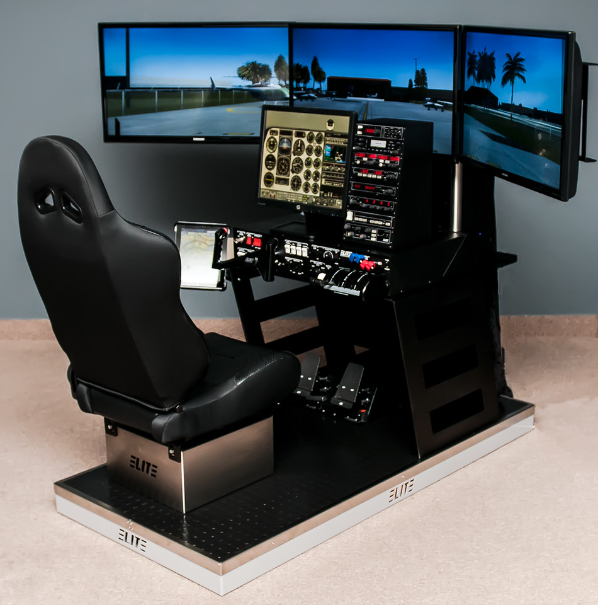
We want a real simulator!
They’re expensive!
This model from Elite costs $9350
Not in the budget

Slide 8
How we got the first one, short version
A guy gave us a chassis (Bart Waclawik; Volair Sim)
Got a computer from John Spizzirri for cheap
Pulled some strings and got money donated
Bought the rest of the components, and the software
Put it together ourselves (Eagle Scout project)
Got Bart to come fix some integration issues; then it ran right
Initially spent about $2100 for everything

Slide 9
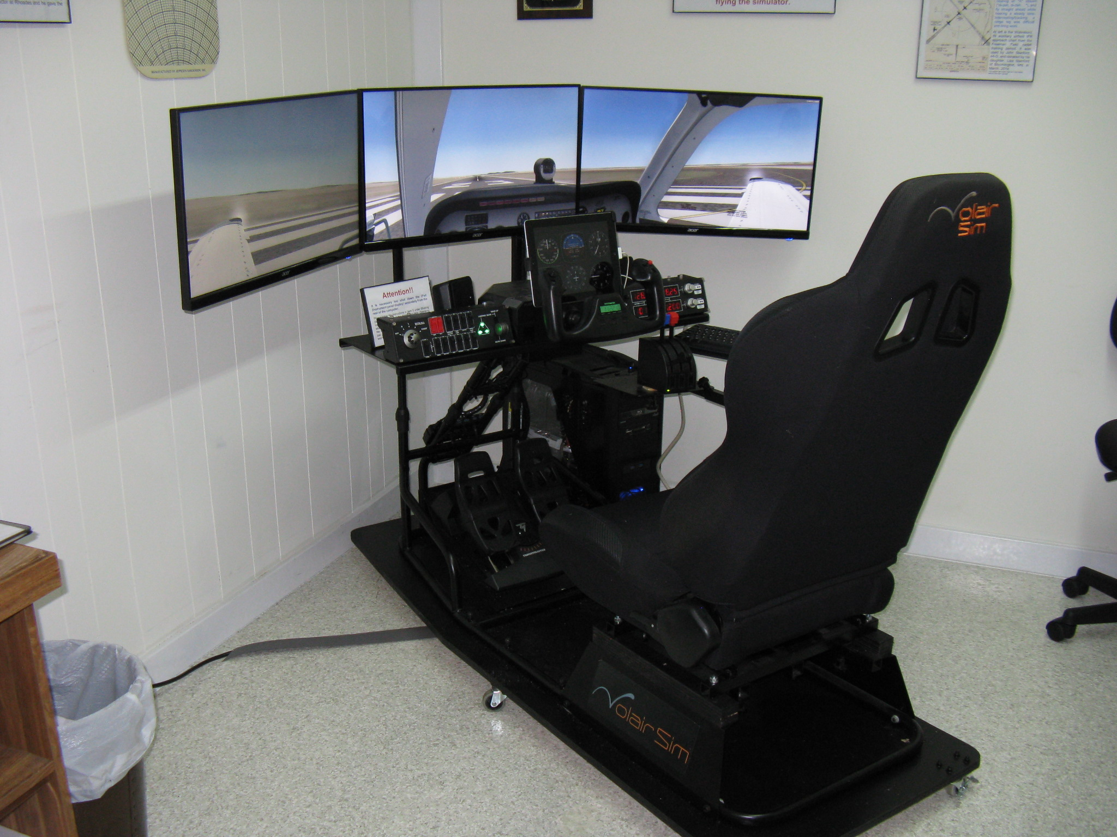
The end result –
Our first simulator

Slide 10
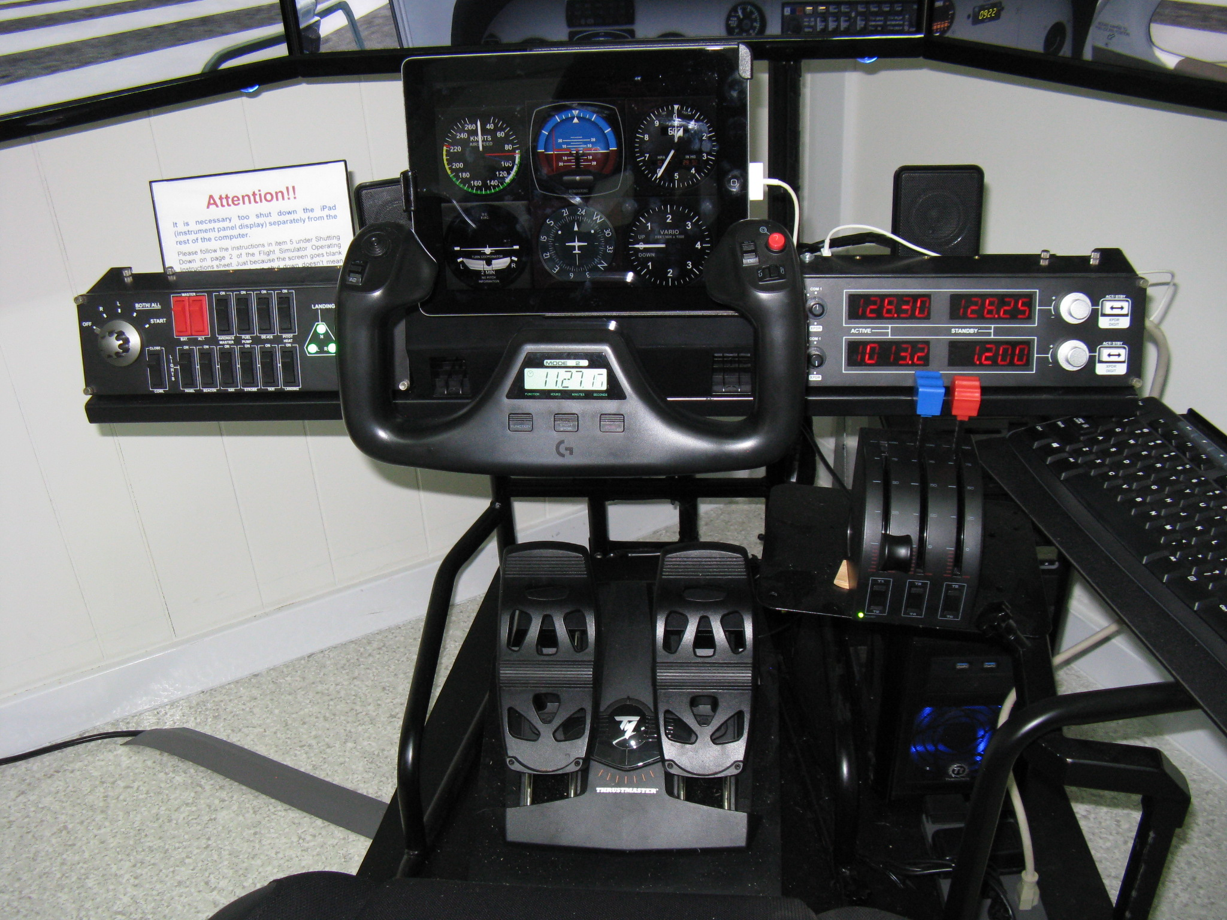
Instrument Panel, Rudders, Throttle

Slide 11
Problems come up, solutions follow
Too complicated for a museum environment
Got rid of switch panel and radio panel
Put flight instruments at the bottom of center main screen
Put Flaps, Trim and Tach indicators on an iPad
Swapped/sold/traded to get better rudder pedals
Got a guy to donate a better yoke

Slide 12
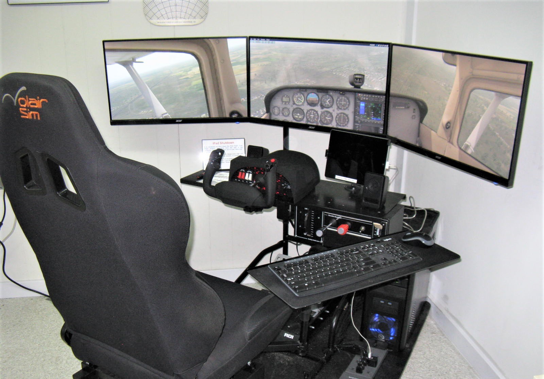
Here’s how it looks today
Changes are:
iPad usage
Instruments on screen
New yoke & rudder pedals
Throttle control box
Different software (xPlane)

Slide 13
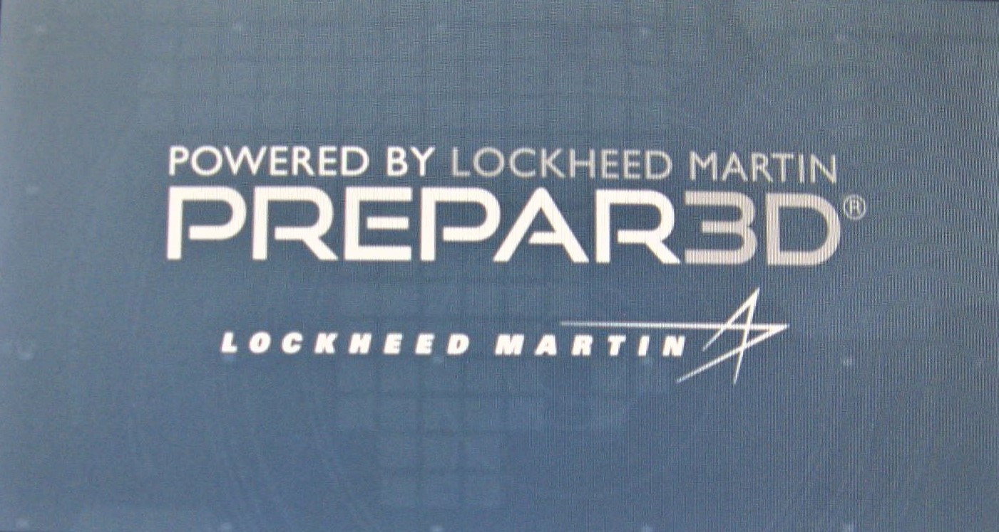
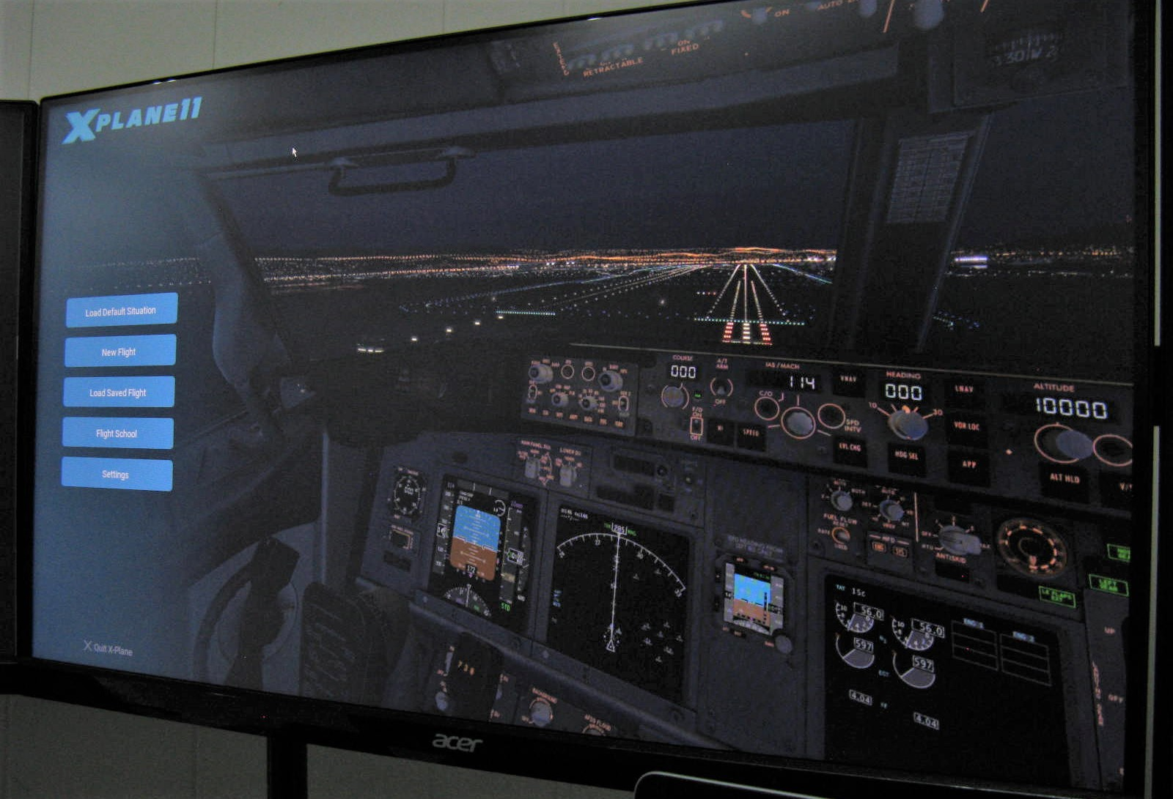
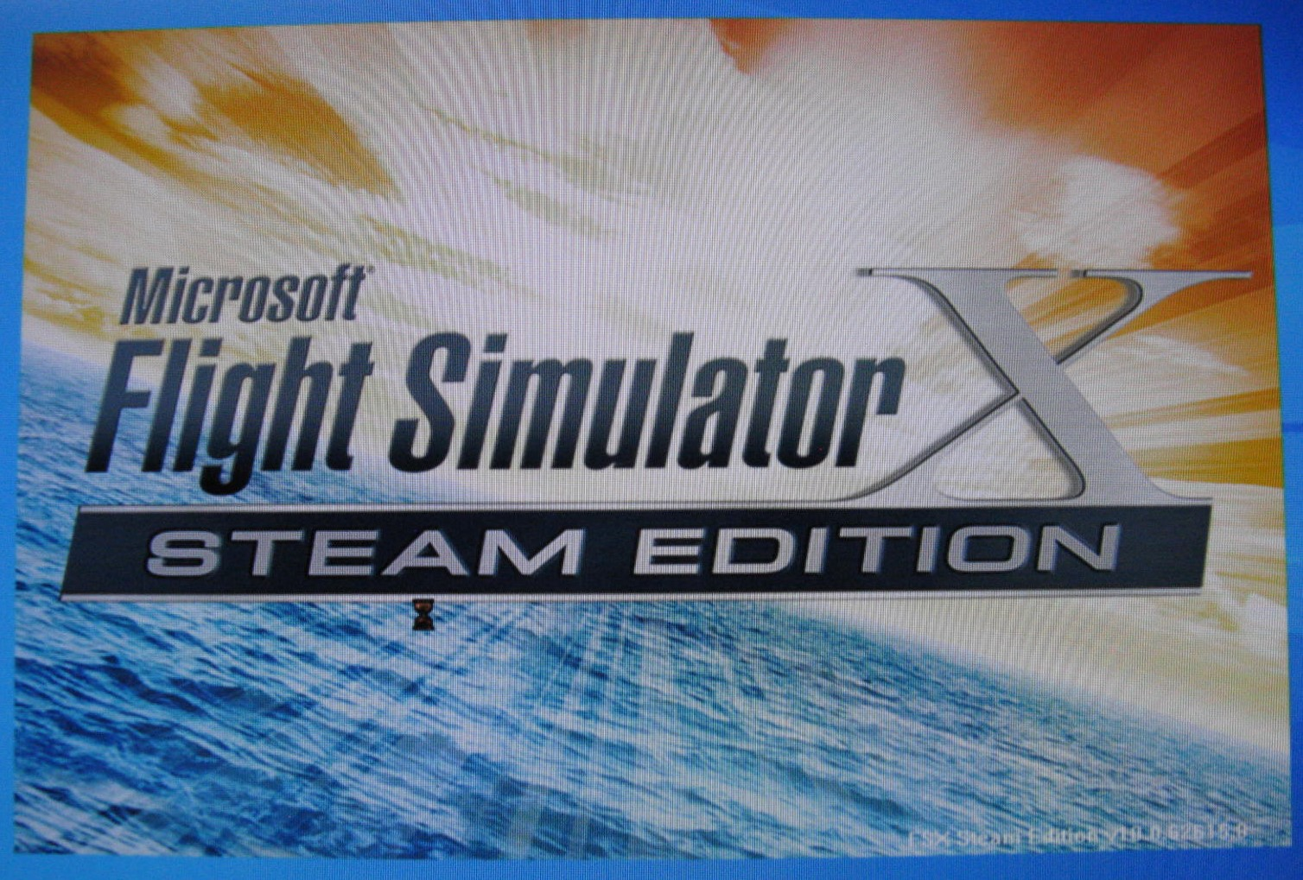
A few words about different simulation software
Prepare3D (P3D)
XPlane
Microsoft FSX
Runs MSE-IN Scenery
Does not have “native” C-172
Difficult to configure controls
Has native C-172
Easy to configure controls
Won’t run with MSE-IN
Has native C-172
Easy to configure controls
Runs MSE-IN scenery
BUT…..
Won’t spread across 3 monitors

Slide 14
One big problem – Little kids want to fly it
But they bang the controls from stop-to-stop, and beat the heck out of them.

Slide 15
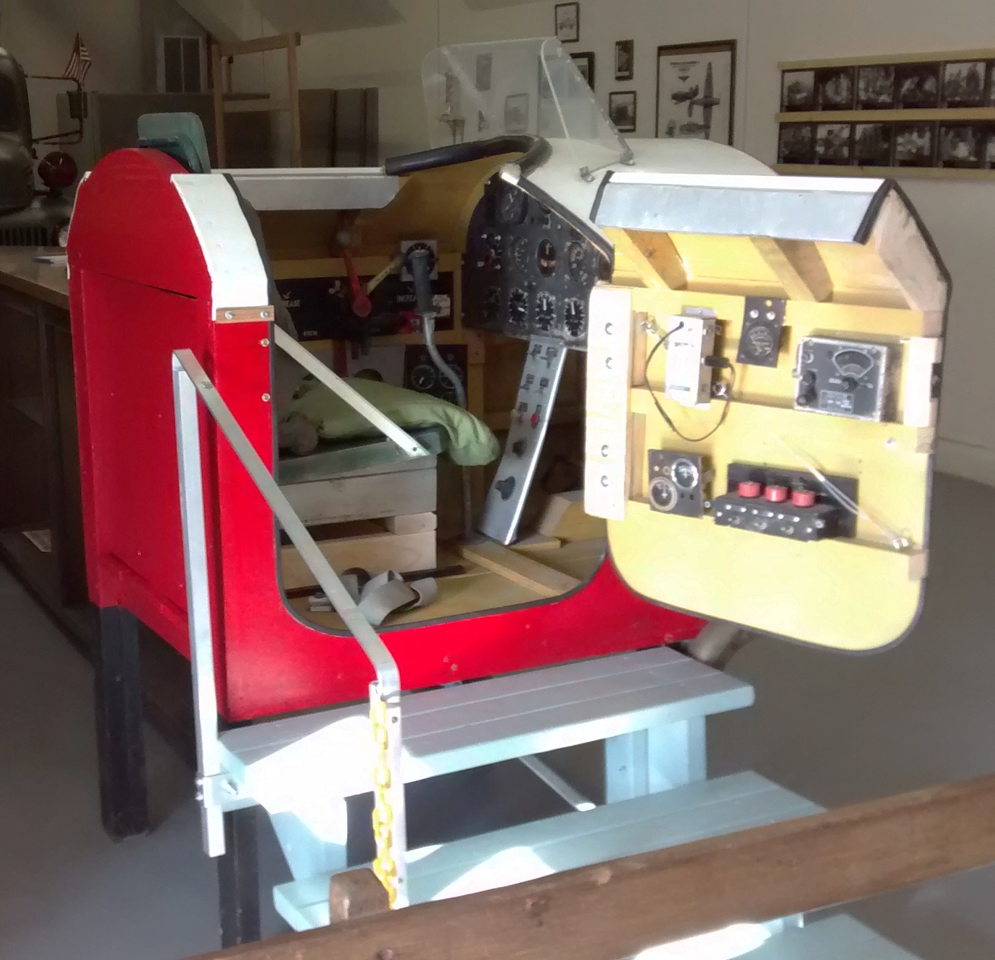
First passive kids version
Kids like it
They can bang the controls around
….. However
No electronics
Not very educational
Terrible seat!

Slide 16
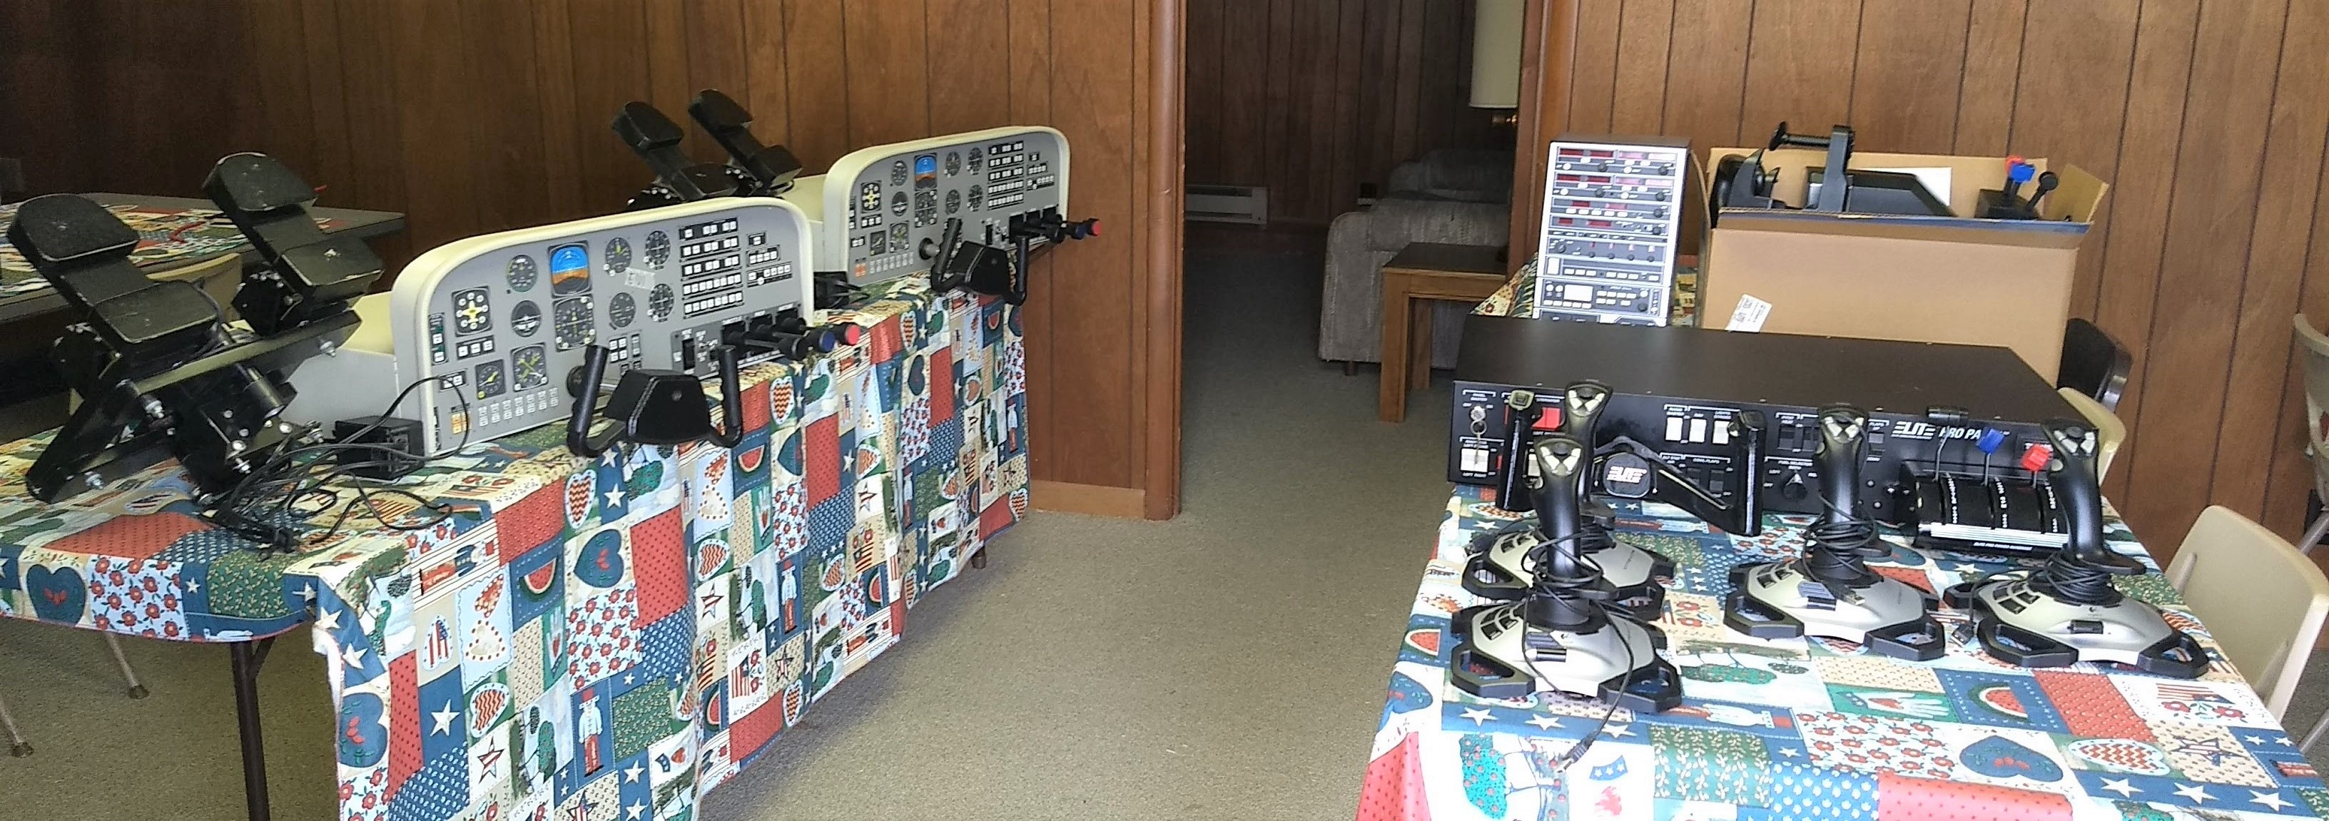
Vincennes Univ in Indianapolis gives us all their old flight sim equipment

Slide 17
We decide to put electronics in the existing kiddie sim. Mods needed.
Make lower to floor
Add computer shelf
Obtain monitor (32” TV)
New seat, adjustable
Obtain iPad
Install joystick
Omit rudder pedals, on purpose

Slide 18
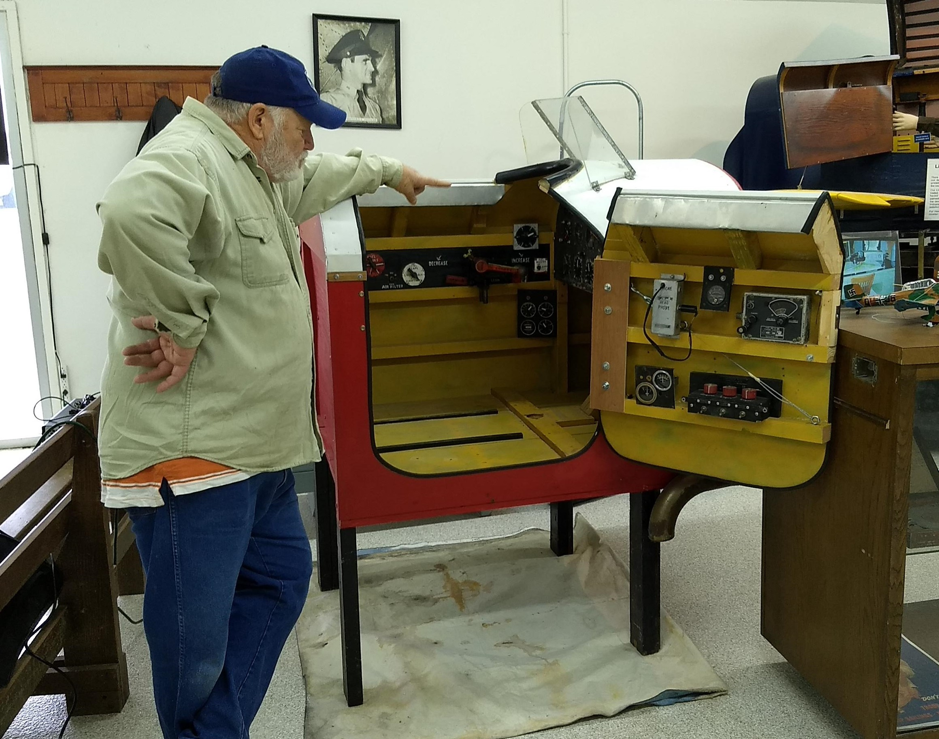
Marty contemplates changes.
Crappy seat has been removed

Slide 19
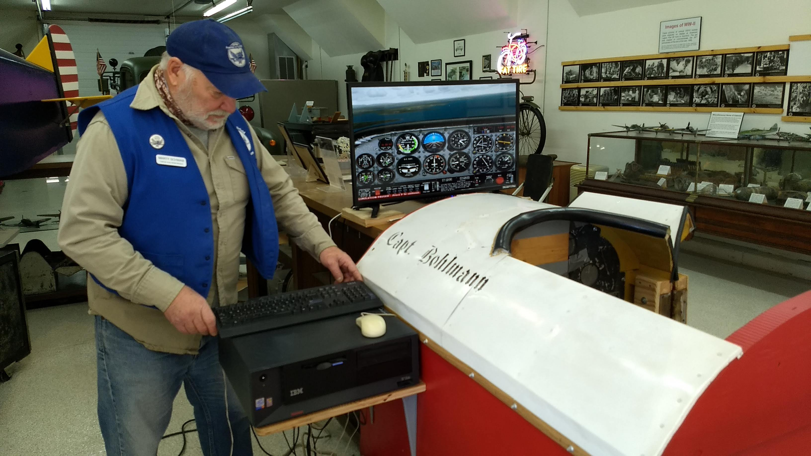
Legs shortened, old computer installed, trial run of electronics

Slide 20
Problems come up; old vs. new
Old software runs on ancient computer, but no browser will run properly in Windows XP, and won’t run Air Manager, the interface program for the iPad (flight instruments).
Newer Win 10 machine connects to the internet, runs Air Manager, but won’t run old Microsoft 2004 simulation.
Ultimate Solution
Larry donates Win-10 machine
Software changed to newer Microsoft FSX
Added benefit: Mega-Scenery Earth for Indiana runs with FSX, so we have good local scenery for the kids. They can find their house or school.

Slide 21
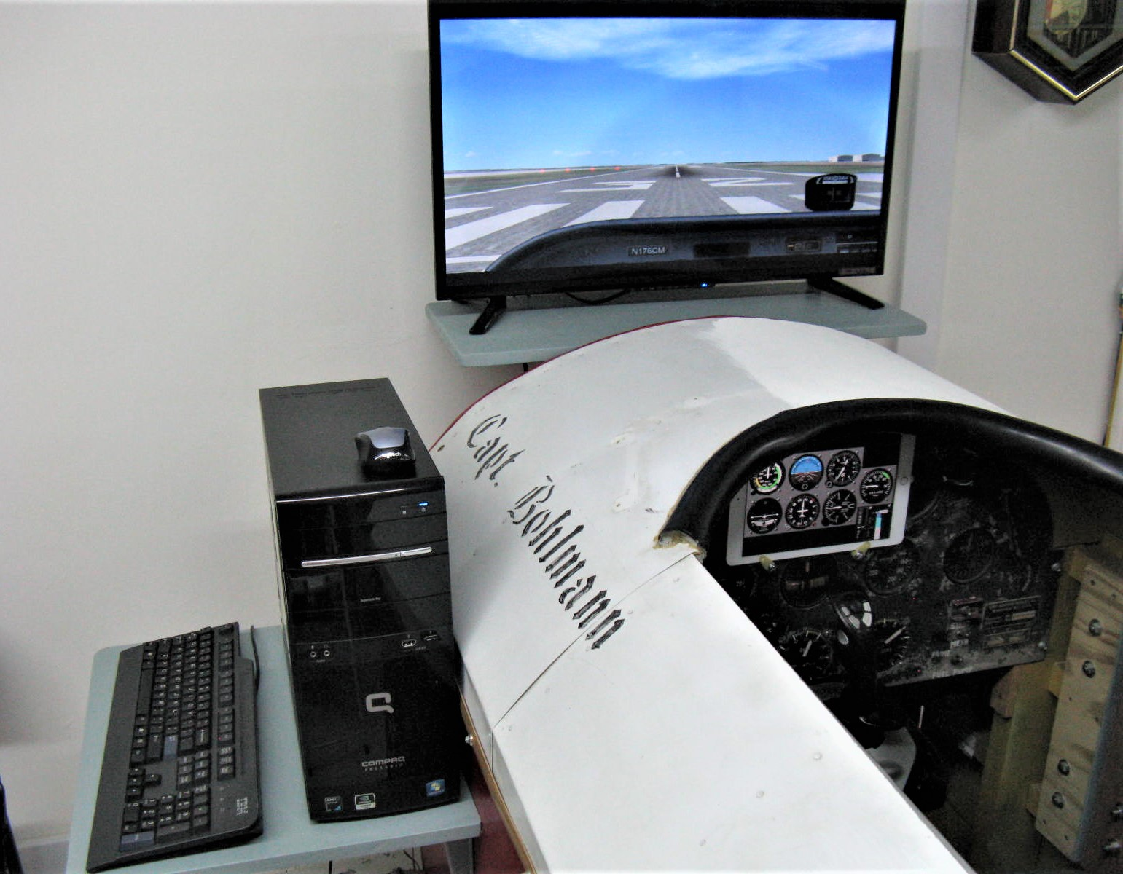
Here’s what the finished kiddie sim looks like

Slide 22
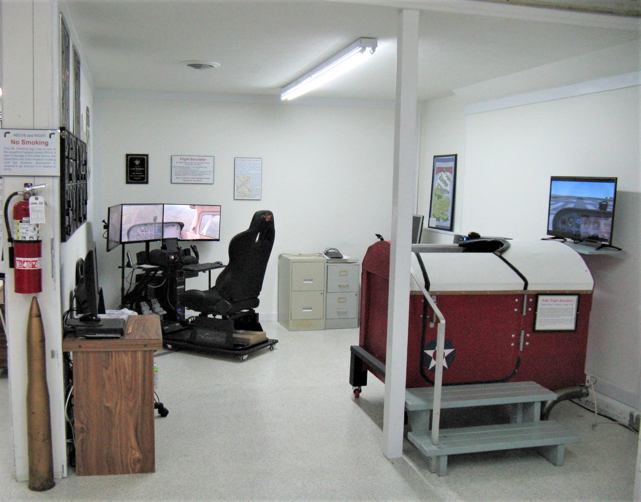
Both simulators in alcove

Slide 23
Plans for the near future
Add easy-to-fly scenarios
Adjust (reduce) sensitivity of some controls
Update simulator operation instruction sheets
Consider changing simulation software to the new Microsoft 2020 flight simulation program.
Further in the future, perhaps add a simulation for the AT-10 twin-engine trainer that was used at Freeman Field during WWII. A group in the UK is creating the simulation, but they aren’t done yet.

Slide 24
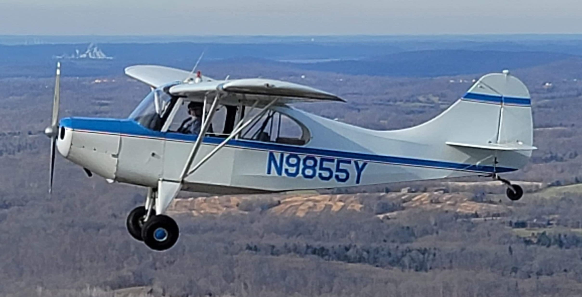
Questions? Comments?
My contact information
Lbothe@comcast.net
Cell Phone: 812-521-7400
My airplane is a 1961 Champion model 7EC “Champ”
If you come to Seymour you can fly the simulators, or the Champ, or both

